Slide 1

Medieval Art Visualization
CAP 5738 Data Visualization
Spring 2018
Dr. Sayeed S. Alam

Slide 2
Introduction
The middle ages (c. 450-1450) was a time of transition and upheaval.
After fall of the Roman Empire in the West, monastic communities arose preservers and disseminators of ancient knowledge, and source of proto-scientific research.
Early scholars grappling with information both sacred and profane invented charts and diagram to confer visual form onto abstract concepts from classical, religious, and secular texts.

Slide 3
Three contributors
Macrobius
Boethius
Isidore of Seville

Slide 4
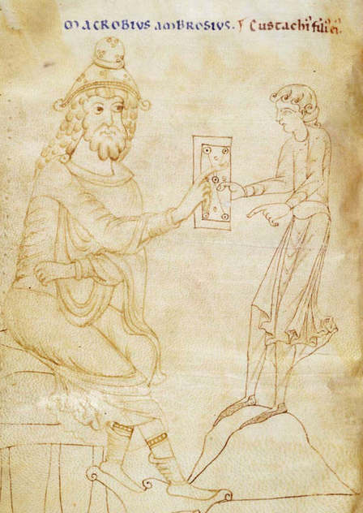
Macrobius
Macrobius Ambrosius Theodosius,
also known as Theodosius
a Roman provincial who lived during the early fifth century, at the transition of the Roman to the Byzantine Empire
He is primarily known for his writings, which include the widely copied and read Commentarii in Somnium Scipionis ("Commentary on the Dream of Scipio")

Slide 5
Commentary on The Dream of Scipio
An explanation and amplification of text from the final section of Cicero’s De republica.
In effect, Scipio’s dream is a cosmological document into an early medieval astronomical primer.
Macrobus relied substantially on visualization as a means for conveying Cicero’s ideas.

Slide 6
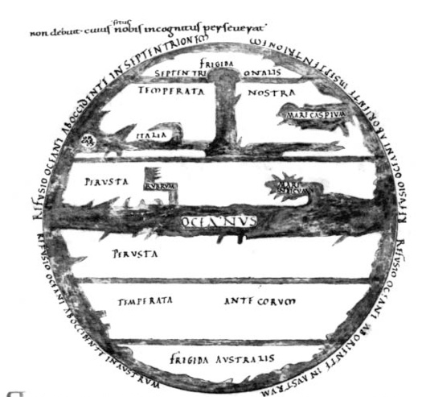
World Map
World Map as Zones.
Northern Frigid
Northern Temperate
Tropical
Southern Temperate
Southern Frigid
Only two of these zones were believed to be inhabitable.

Slide 7
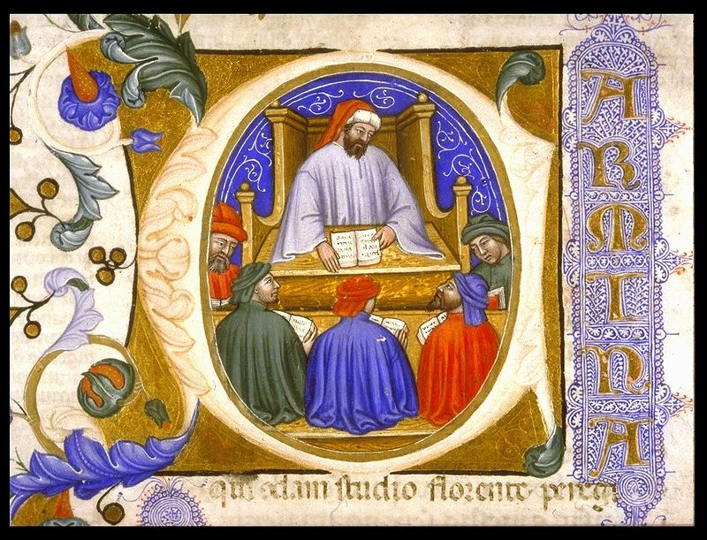
Boethius
Boethius along with Augustine and Aristotle is considered to be the fundamental philosophical author of late antiquity.
Source of his works:
De institutione arithmetica
De institutione musica

Slide 8
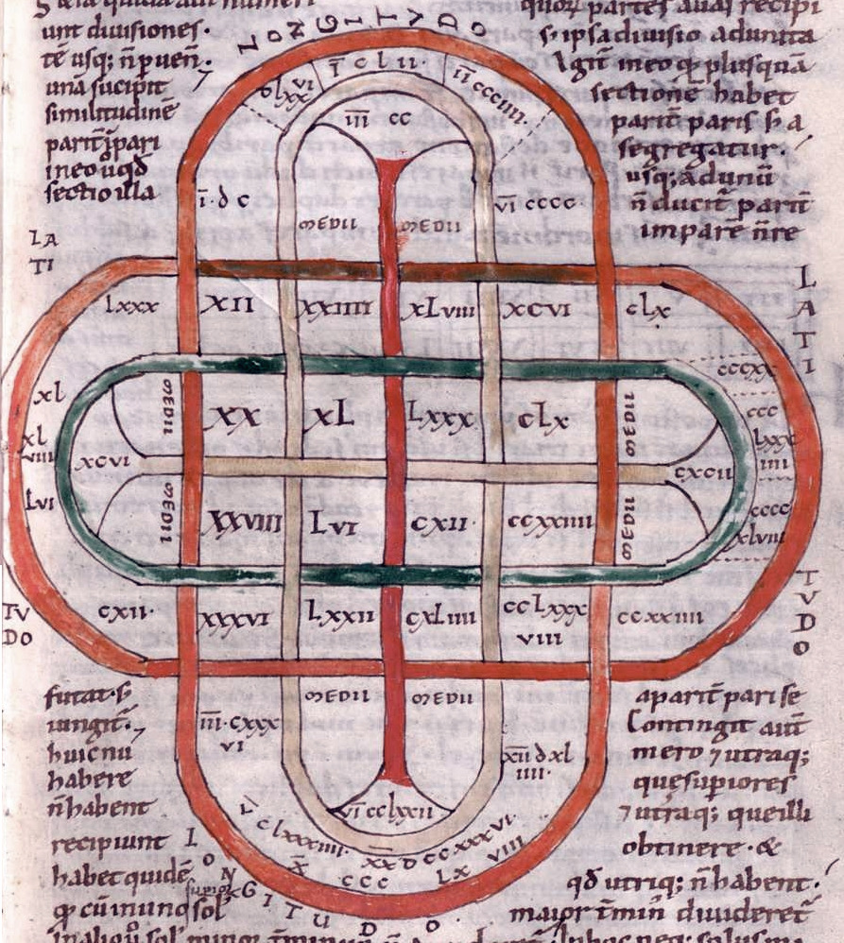
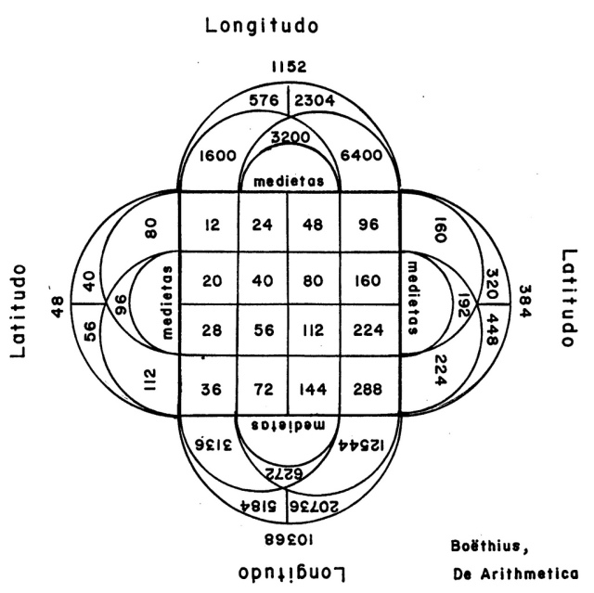
Arithmetic Diagram by Boethius

Slide 9
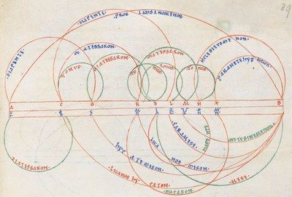
Musical arc Diagram for monochord by Boethius

Slide 10
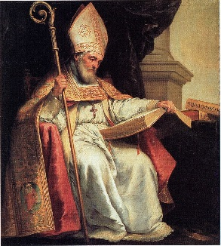
Isidore of Seville
Isidore of Seville (c. 560 – 636) is considered one of the greatest scholars of late antiquity who is best known as the first encyclopedist of the Middle Ages.
His Etymologiae (Etymologies) is an encyclopedic work in twenty books.

Slide 11
De natura rerum Rotae
Isidore of Seville also wrote De natura rerum.
De natura rerum contains six circular diagram called rotae.
We consider two rotae.
Calendar
Annus-Mundus-Homo

Slide 12
Calendar, De natura rerum
Calendar, De natura rerum
c. 760-780

Slide 13
Annus-Mundus-Homo Diagram
Ignis – Fire
Terra – Earth
Aer – Air
Aqua – Water
Calidus – Hot
Frigida – Icy
Sicca - Dryness
Colera – Anger
Sangus – Optimistic
Melancholia- Sadness
Humor

Slide 14
Greco Roman Designs
Neptune Mosaic
4 Women 4 seasons

Slide 15
Conclusion
Macrobius, Boethius, and Isidore of Seville ‘s manuscripts were revived in the Renaissance as part of cultural and educational reform.
It may not be the act of invention that make these visualizations important but rather their innovative application and extension that marks these works as special.

Slide 16
References
Marchese, Francis T. "Medieval information visualization." Proceedings of the IEEE VIS Arts Program (VISAP) (2013).

Slide 17
Thank You

